Slide 1
MEDICAL IMAGE PROCESSING
FOREIGN OBJECT DETECTION
X - RAY CHEST IMAGES

Slide 2

TEAM MEMBERS 1:
Nguyễn Cường Phát – 14155
Phạm Gia Bảo – 13131
Nguyễn Quý Minh – 13119
TEAM MEMBERS 2:
Đặng Kim Bảo – 13087
Trần Minh Long – 1???
Đinh Hà Nguyên – 1???
Nguyễn Trần Quang Anh – 1???

Slide 3
Two methods
With the same problem
Differences
05
The same problem
For the same problems – Foreign Object Detection (X – Ray image).
But using different methods for finding which framework/algorithm provide a better result in the reality or study.
04
YOLOV5 - RCNN
03
02
01
Performances
Pros vs Cons
How can it implement?
Which is more accurate?
Which is better for detecting object

Slide 4
Outline
01
Dataset Overview
02
Build Custom Dataset
03
Data Training
04
Result Visualization
05
Compare & Analyze

Slide 5
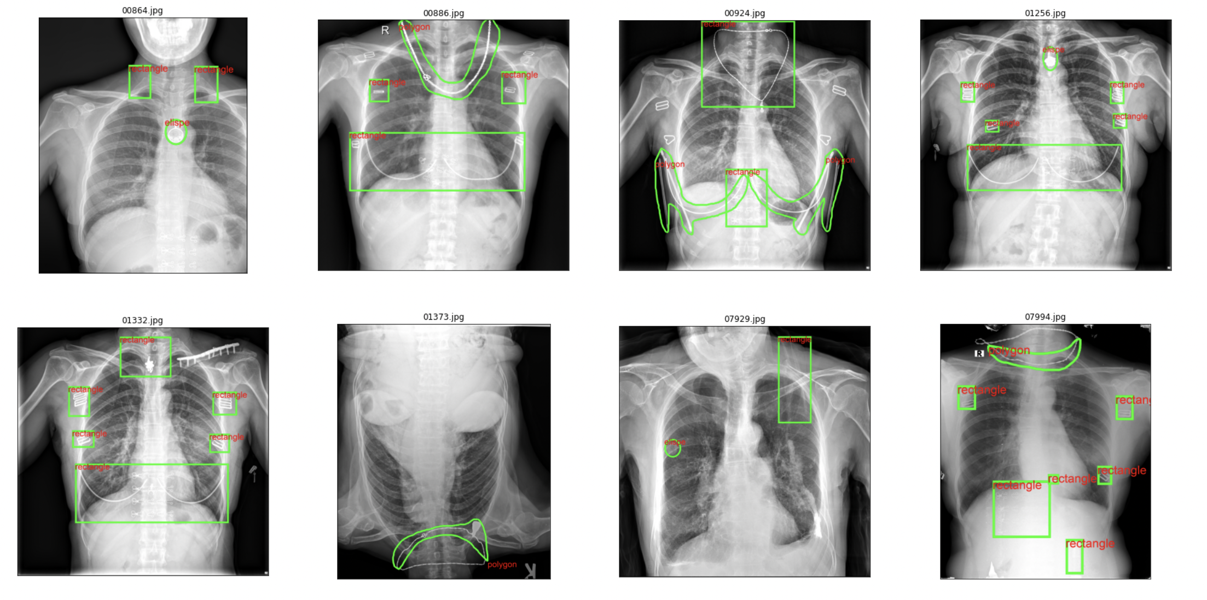
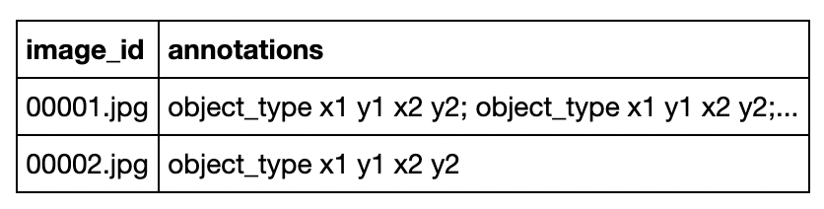
Dataset Overview
Train and Validation Data
01
Data
4000 chest images with foreign object presented and 4000 images without object presented. Foreign object include: bounding boxes, bounding eclipse or object mask
1000 images for evaluating
02
Annotation
03
Visualize Dataset
8000 pictures in /content/drive/MyDrive/MIP Resource/ChestXrayDataSet/customDataSet/images/train
1000 pictures in /content/drive/MyDrive/MIP Resource/ChestXrayDataSet/customDataSet/images/dev
For rectangle and ellipse annotations, the bounding box is (upper left and lower right) coordinates in the format x1 y1 x2 y2 where x1 < x2 and y1 < y2.
For polygon annotations, the coordinates in the format x1 y1 x2 y2 ... xn yn

Slide 6
YOLOV5 vs Faster-RCNN
Definition
One of the famous object detection architectures that uses convolution neural networks
Definition
YOLO is one of the most versatile and famous object detection models
Pros
Using fewer proposal in Faster R-CNN will not result in a big loss in accuracy
Better time than other RCNN
Pros
Easy to train and do inference.
Widely used.
Cons
Running time depends on the number of proposal
The selective search algorithm is a fixed algorithm. Therefore, no learning is happening at that stage
Cons
Heaviest amongst other versions.
Time-consuming.
Application
Real-time object detection.
Application
Can be used in real time detection
Notes:
Một kỹ thuật được sử dụng để đề xuất các region proposal hoặc các bounding box chứa các đối tượng tiềm năng trong hình ảnh là selective search

Slide 7
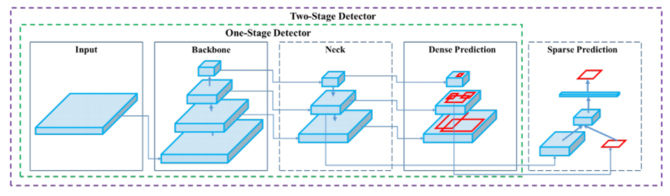
One-Stage
Detector

Slide 8
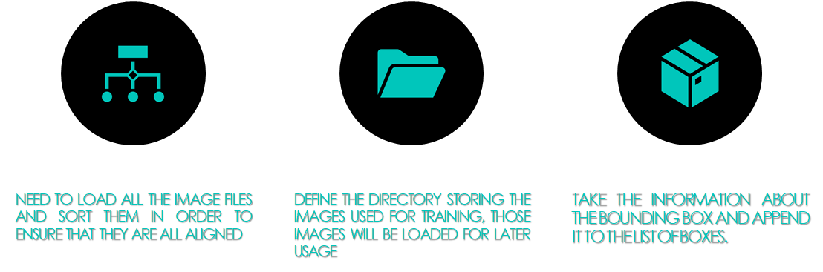
Defining the dataset for foreign objects

Slide 9
if self.datatype == 'train':
annotation = self.labels_dict[img_name]
boxes = []
if type(annotation) == str:
annotation_list = annotation.split(';')
for anno in annotation_list:
x = []
y = []
anno = anno[2:]
anno = anno.split(' ')
for i in range(len(anno)):
if i % 2 == 0:
x.append(float(anno[i]))
else:
y.append(float(anno[i]))
xmin = min(x)/width * 600
xmax = max(x)/width * 600
ymin = min(y)/height * 600
ymax = max(y)/height * 600
boxes.append([xmin, ymin, xmax, ymax])

Slide 10
Defining the dataset for foreign objects
Convert everything into a torch.Tensor, which is a multi-dimensional matrix containing elements of a single data type, and suppose that all instances are not crowded.
target["boxes"] = boxes
target["labels"] = labels
target["image_id"] = image_id
target["area"] = area
target["iscrowd"] = iscrowd

Slide 11
Defining the dataset for foreign objects
Define the dataset for validating and testing
if self.datatype == 'dev':
if self.labels_dict[img_name] == '':
label = 0
else:
label = 1
if self.transform is not None:
img = self.transform(img)
return img, label, width, heigh

Slide 12
Set up detection model
LOAD A MODEL PRE-TRAINED ON COCO
01
GET THE INPUT FEATURES
02
REPLACE THE PRE-TRAINED HEAD WITH THE NEW ONE
03
I hope and I believe that this Template will your Time, Money and Reputation. Get a modern PowerPoint Presentation that is beautifully designed.
04

Slide 13
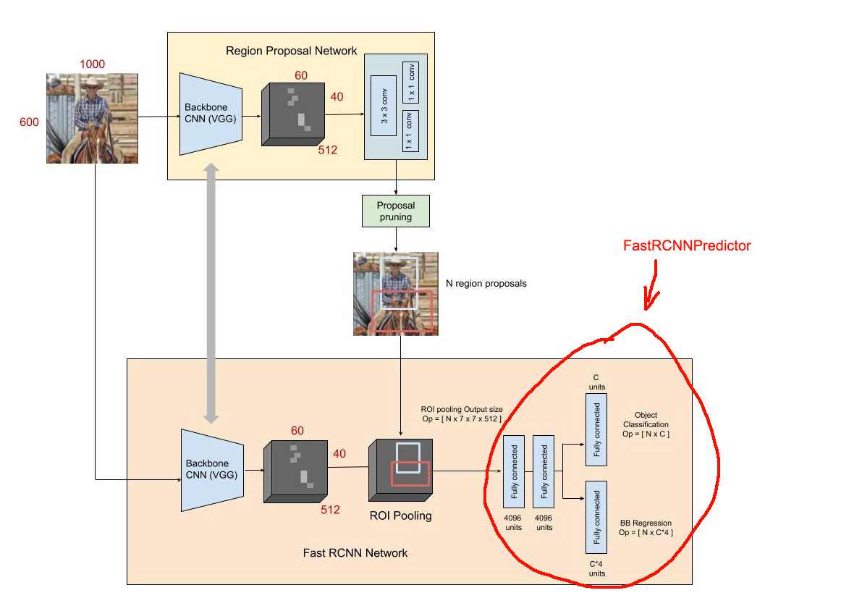
Faster RCNN
Notes:
Input đầu vào được đưa qua 1 CNN backbone (VGG, ResNet... ) để trích xuất ra FeatureMap. Tại đây, feature map được đưa qua 1 lớp Convolution để sinh ra các Proposal regions. Đây là các vùng có khả năng chứa object. Dựa vào các Proposal regions này, ta tiến hành tách/cắt FeatureMap để thu được 1 tập các sub-feature tương ứng với từng vùng này. Các sub-feature này có kích thước khác nhau, ta cần bước ROI Pooling để thu được các sub-feature có kích thước như nhau
Với từng sub-feature, ta đưa qua 1 Fully-connected network để thu được output gồm Class distribution và Bounding Box

Slide 14
Training Procedure
Standardize the dataset
Load data by using data loader
resize the image to 600x600 pixels
batch 4 - 4 images per batch
epochs 6
Input into the defined model
Construct the optimizer
Set up learning rate scheduler
Stochastic gradient descent
Decreases the learning rate by 10x every 2 epochs)
Notes:
(Batch size)defines the number of samples to work through before updating the internal model parameters.)
Stochastic gradient descent có momentum

Slide 15
Epoch
What is Epoch?
Defines the number times that the learning algorithm will work through the entire training dataset.
Train Epoch
https://github.com/pytorch/vision/blob/master/references/detection/engine.py
Update the learning rate
Decreases the learning rate by 10x every 2 epochs
Labeling
ACC & AUC
Label by using the maximum confidence scores per image
ACC = Number of correct label compare to original dataset
AUC = Predicted label and original label (Using ROC
Notes:
8000 images, batch size = 4 =>8000/4 iterations for 1 epoch
> 0.5 thì label 1, < 0.5 thì label 0

Slide 16
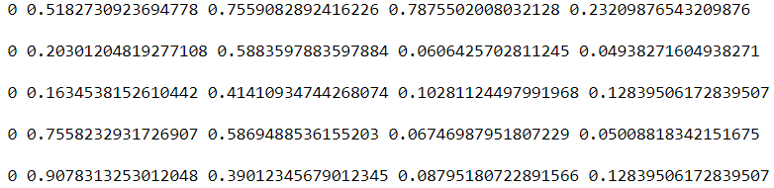
Custom Dataset
DARKNET FORMAT

Slide 17
Dataset Overview
Train and Validation Data
01
Data
4000 chest images with foreign object presented and 4000 images without object presented. Foreign object include: bounding boxes, bounding eclipse or object mask
1000 images for evaluating
02
Annotation
03
Visualize Dataset
8000 pictures in /content/drive/MyDrive/MIP Resource/ChestXrayDataSet/customDataSet/images/train
1000 pictures in /content/drive/MyDrive/MIP Resource/ChestXrayDataSet/customDataSet/images/dev
For rectangle and ellipse annotations, the bounding box is (upper left and lower right) coordinates in the format x1 y1 x2 y2 where x1 < x2 and y1 < y2.
For polygon annotations, the coordinates in the format x1 y1 x2 y2 ... xn yn

Slide 18
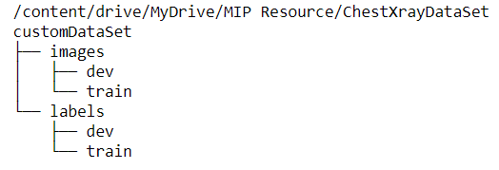
TREE
STRUCTURE

Slide 19
Train model
%cd '/content/drive/MyDrive/MIP Resource/ChestXrayDataSet'
git clone https://github.com/ultralytics/yolov5
%cd yolov5/
pip install -r requirements.txt

Slide 20
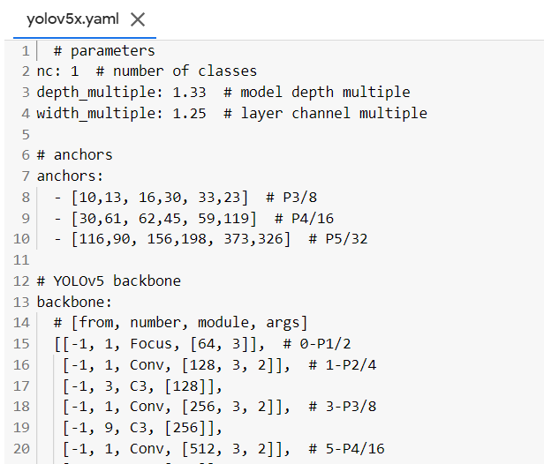
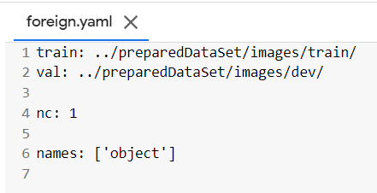
TRAINING
PROCEDURE
MODEL CONFIGURATION
DATA CONFIGURATION

Slide 21
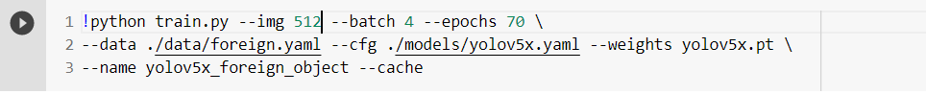
Training Procedure
img 512- resize the image to 512x512 pixels
batch 4 - 4 images per batch
epochs 70 - train for 70 epochs data ./data/foreign.yaml - path to dataset config
cfg ./models/yolov5x.yaml - model config
weights yolov5x.pt - use weights from the YOLOv5x model
name yolo5x_foreign_object - name for our model
cache - cache dataset images for faster training

Slide 22
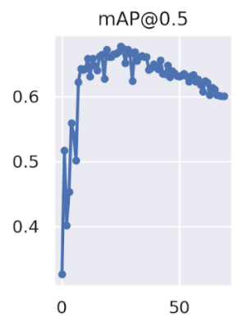
MEAN Average
Precision
70 EPOCHs
BEST MODEL FOR CHECKPOINT

Slide 23
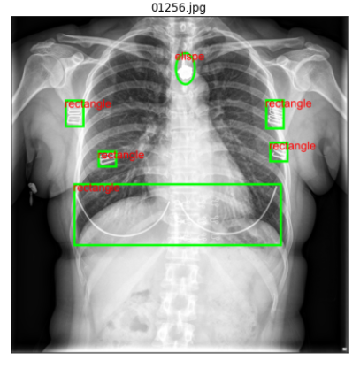
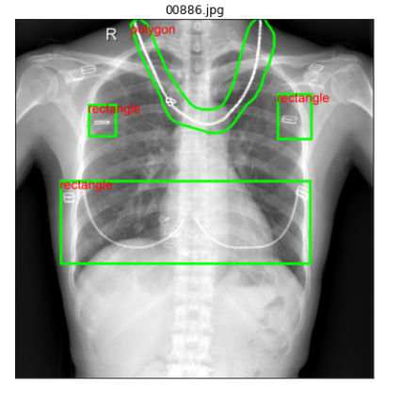
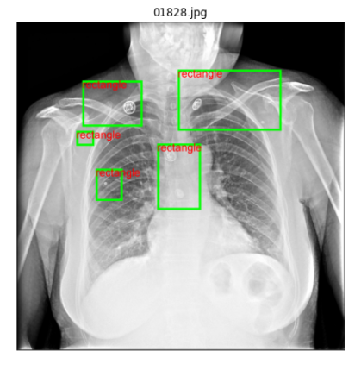
DATASET WEAKNESS

Slide 24
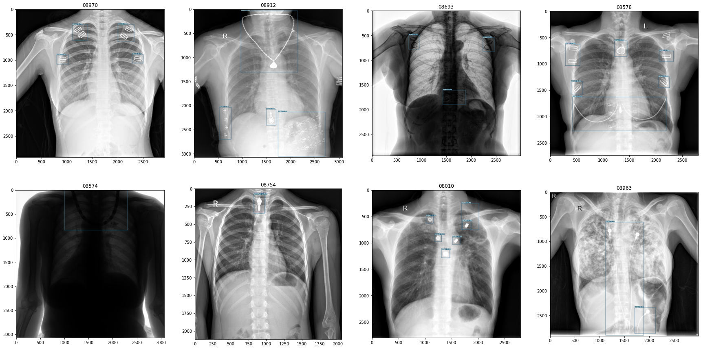
YOLOV5 RESULT

Slide 25
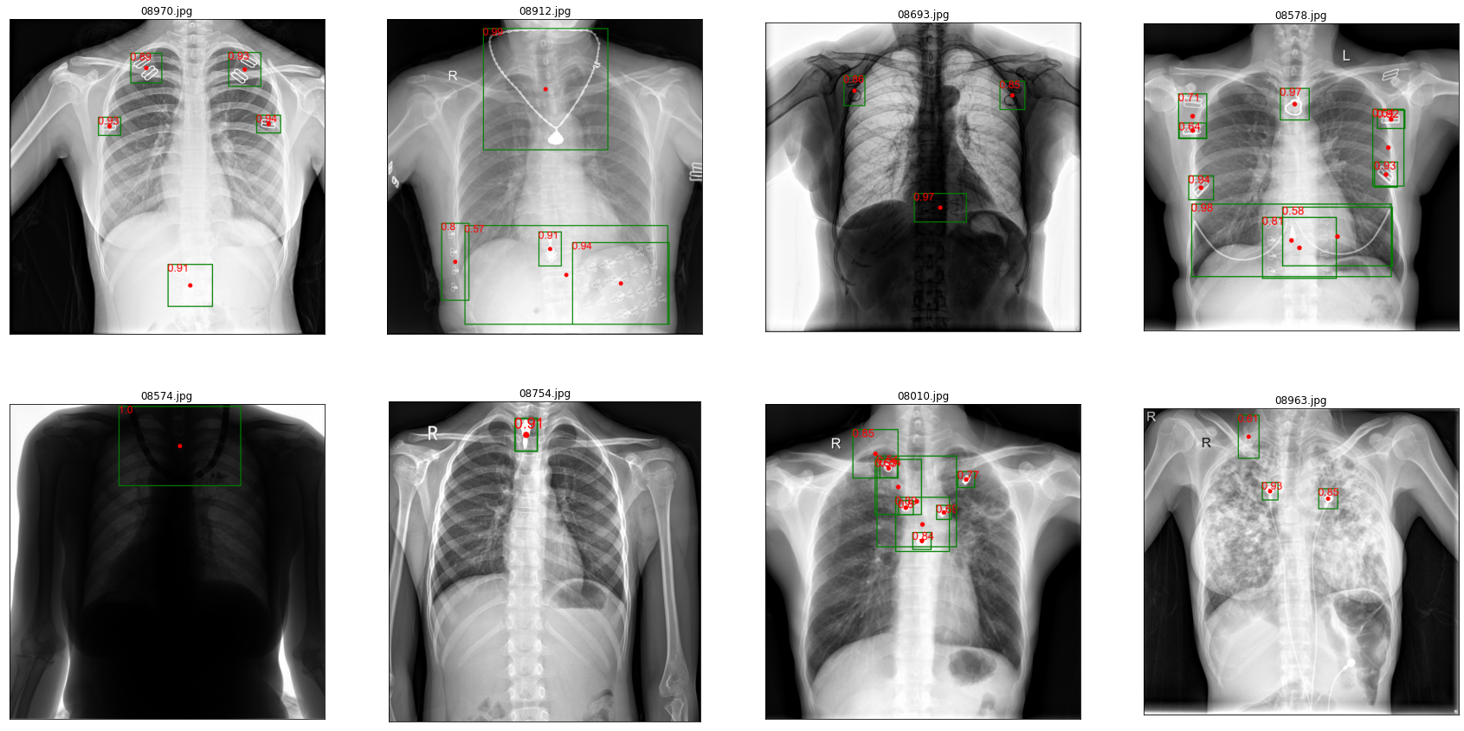
RCNN RESULT

Slide 26
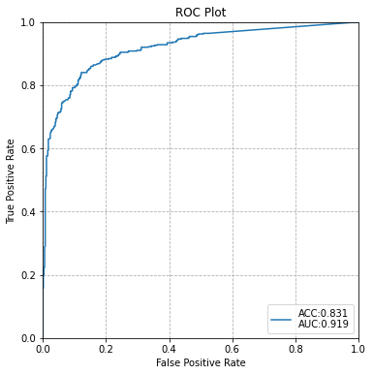
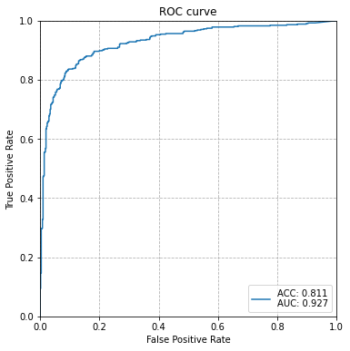
RCNN ANALYZE
YOLOV5
FASTER RCNN

Slide 27
FROC
WHY?
TRUE POSITIVE
FALSE POSITIVE
SENSITIVE
Because our object annotations are provided in different format
A foreign object is counted as detected as long as one predicted center coordinate lies within its original dataset bounding box.
A predictived coordinate is false positive, if it lies outside any foreign object annotation
The sensitivity is the number of detected foreign objects dividied by the number of total foreign objects.

Slide 28
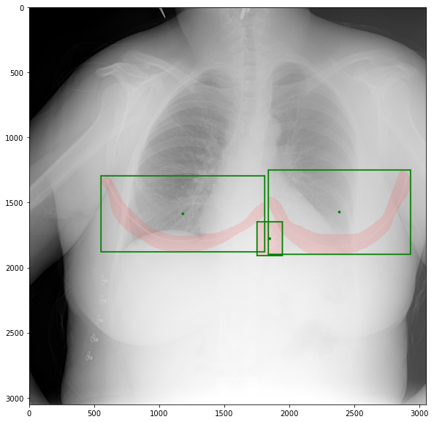
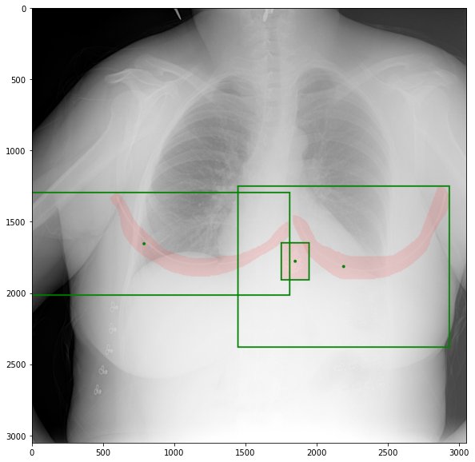
TRUE POSITIVE

Slide 29
FROC
01
SENSITIVITY = CORRECT DETECTED BBOX / TOTAL BOX
02
FALSE POSITIVE PER IMAGE = TOTAL FALSE BBOX / NUMBER OF IMAGE

Slide 30
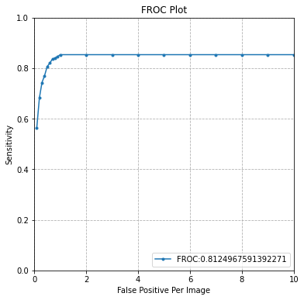
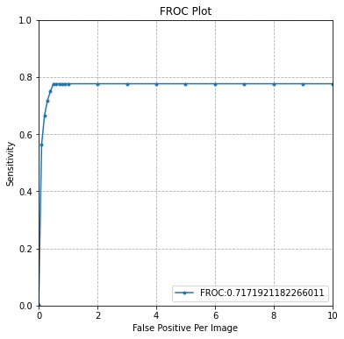
FROC Analysis
01
02
Faster-RCNN (0.2)
YOLOV5

Slide 31
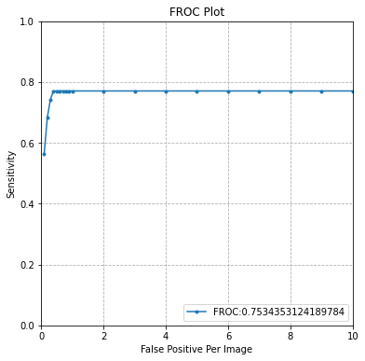
FROC Analysis
01
02
Faster-RCNN (0.2)
Faster-RCNN (0.5)

Slide 32
FROC
The more false positive per image we have, the more sensitivity value we obtain.
The higher the threshold, the more possibility that a prediction can be missed

Slide 33
CONCLUDE
Faster-RCNN:
High confidence
Many overlap prediction (but only lower confidence)
More complicated to implement
YOLO:
Low confidence
Every object is clearly classified
Easy to use

Slide 34
THANK YOU

